Slide 1
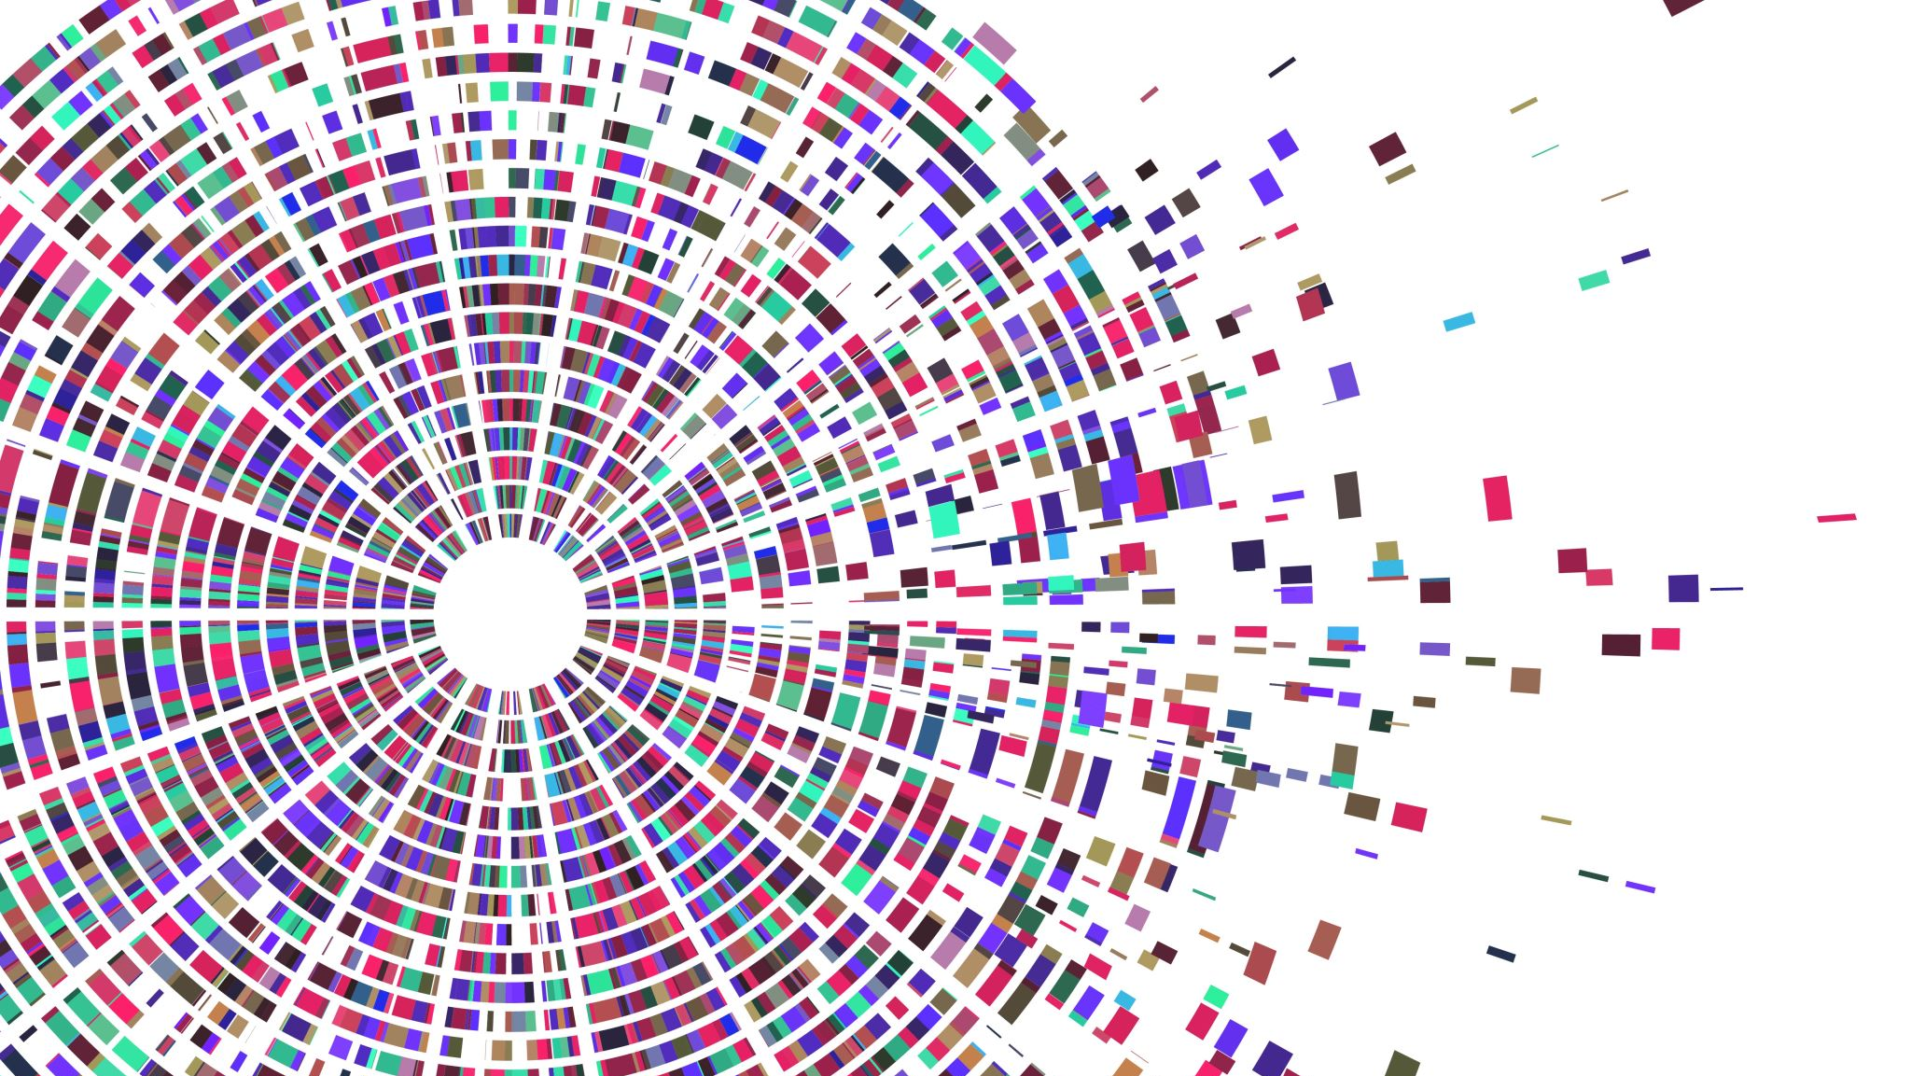

Genetic Algorithm Isaac Jones
modern problems (sometimes) require ancient solutions

Slide 2
Video Layout
Evolution
Genes
Mutation
Survival
Reproduction
Genetic Algorithm
Genes
Mutation
Elitism / Weak Subset
Survival
Reproduction
Usages
Monkey on a Typewriter
My Approach
Enter players 1-4
Maths (big numbers)
Findings
Recap

Slide 3
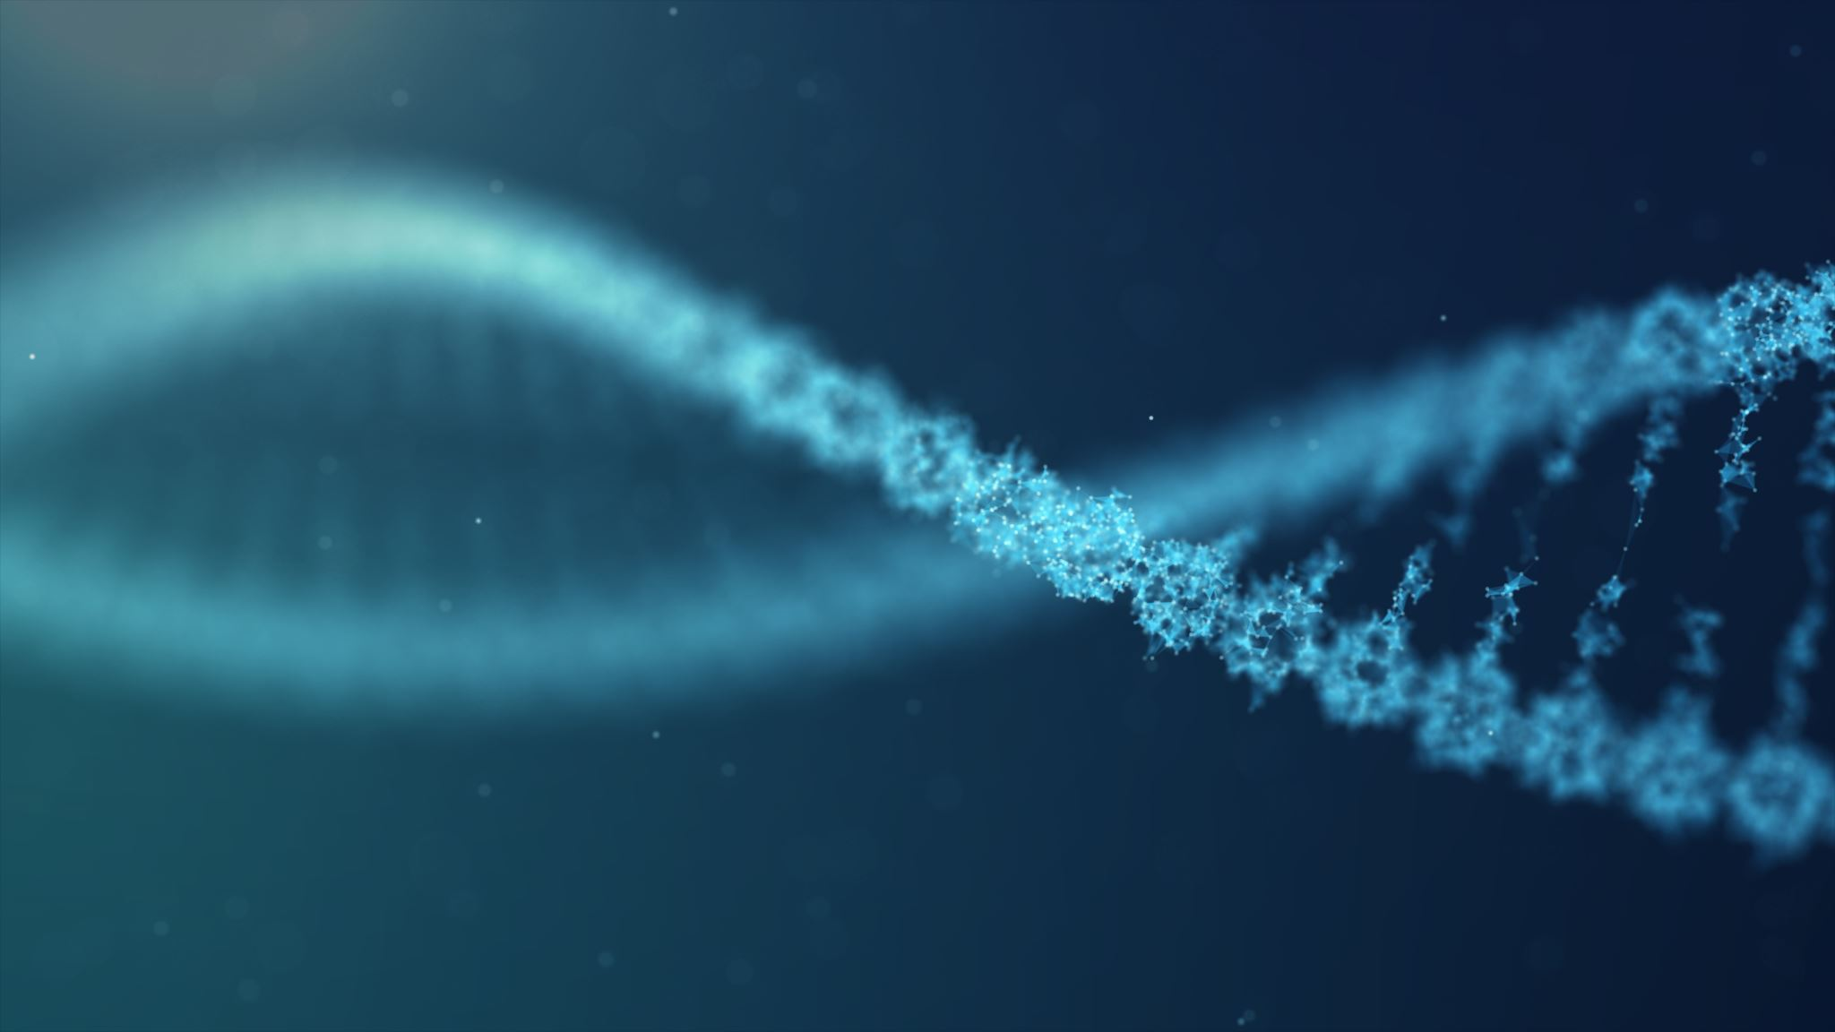
Evolution
Genes
Component Parts
Encouraging or Aiding Behavior
Mutation
Mummy and a Daddy block who love each other very much
Survival
Rinse and Repeat

Slide 4
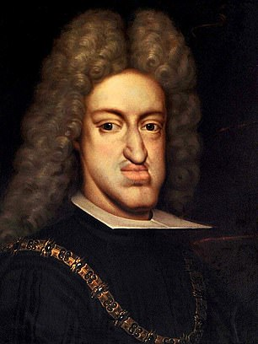
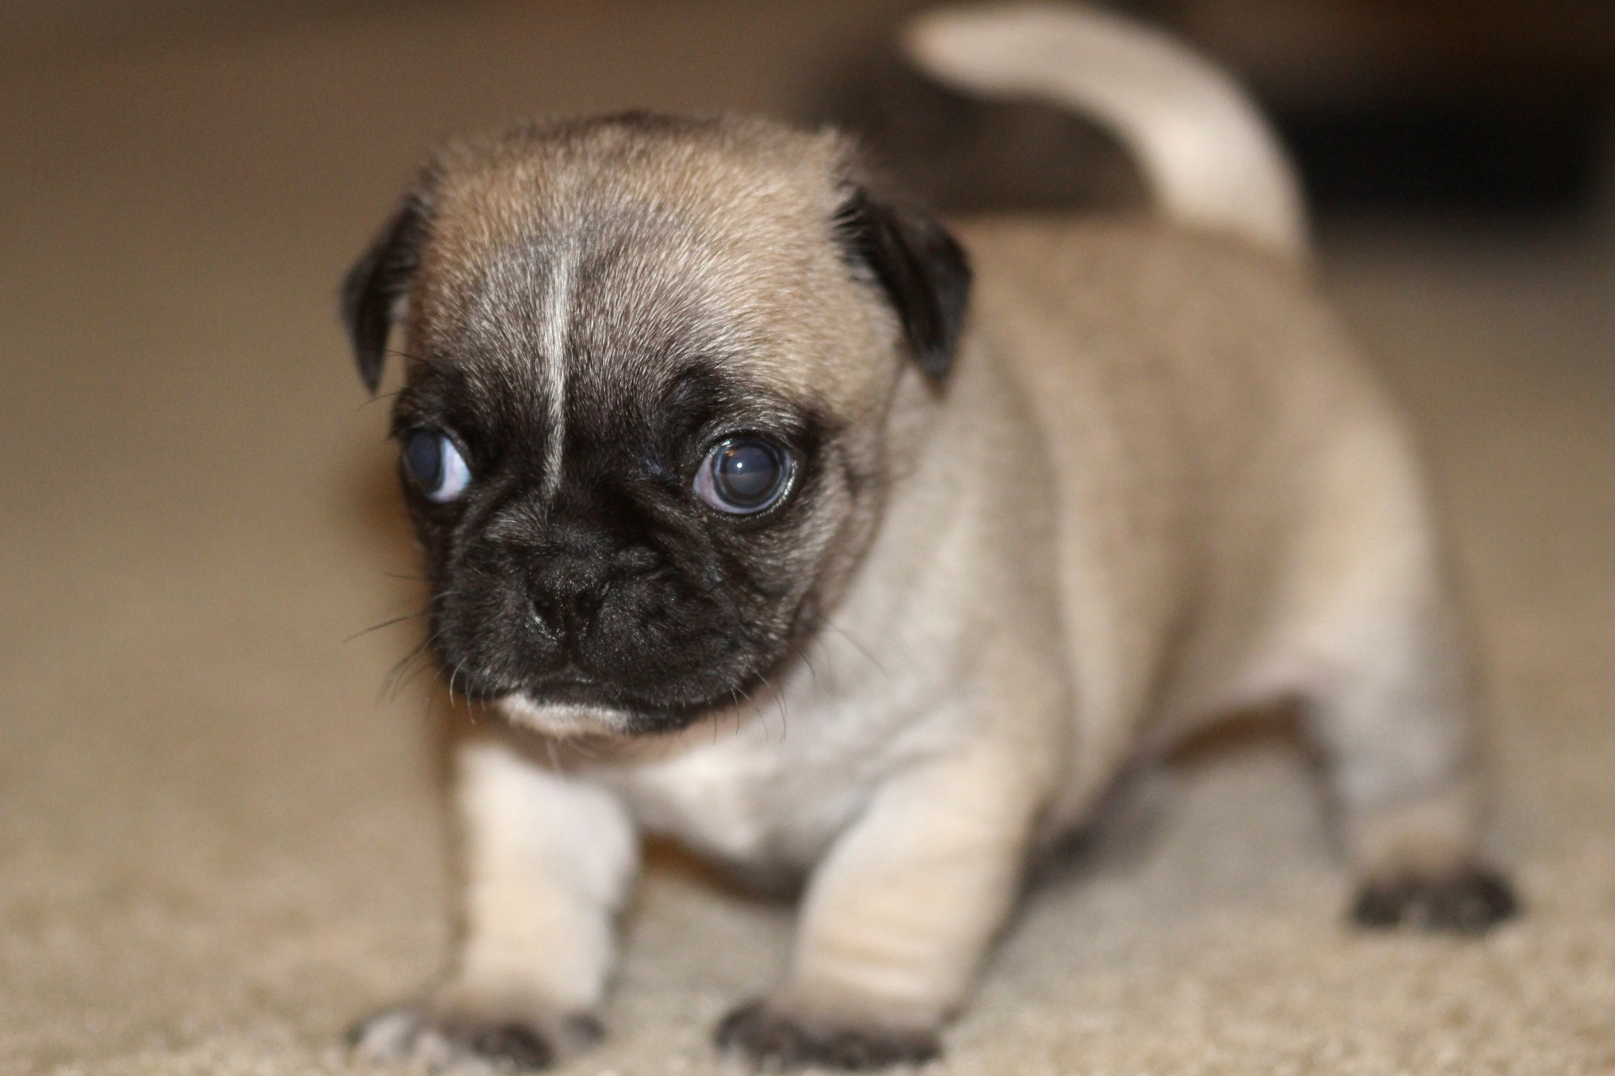
Genetic Algorithm
Genes
Collection of stats, weightings, component parts
Stored in custom variables or a collection of premade variable types
Mutation
Randomisation in starting position and throughout the gene pool
Ward against stagnation
Elitism / Weak Subset
Helps rapidly aid development
Inbreeding apply
Survival
Fitness value
Reproduction
Fitness value
Genes
Mutation
Elitism / Weak Subset
Survival
Reproduction

Slide 5
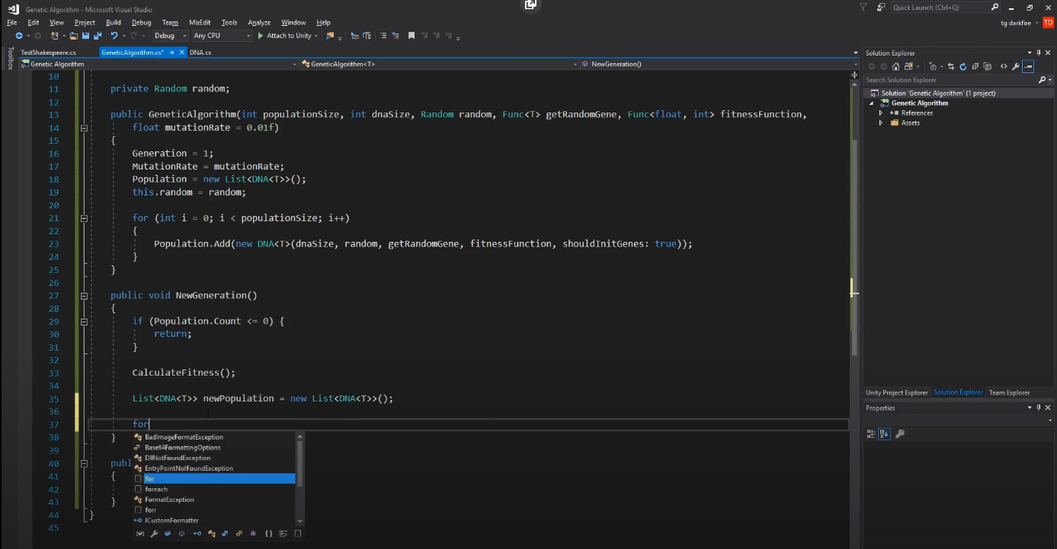
Monkey on a typewriter
Genetic Algorithm C# - Generic Implementation - Kryzarel
The Maths
https://www.youtube.com/watch?v=G8KJWONEeGo&list=PLm7W8dbdfloi6DOIQDqfTx0DjGwo6tGqm&index
“To be or not to be, that is the question.”
41 characters
26 Letters +3 punctuation = 29
41! / 29! x 12! = 7.9 × 10^9
Lottery is 4.5 *10^7 = 200 in a row
~100 – 200 (just a lil faster)

Slide 6

My Approach
A not so small reason via maths
(100 * 100 * 100) = Million
Just for Plant vs Plant reaction
Plant vs (x3 others) = 1x10^24
Others to work out for…
1x10^96
Only for one population layout
Spoiler: Plants (5k) Herbivores(1.2k) Carnivores (200), Omnivores (400)
4.8x10^104 …which is the final stages of the heat death of the universe from the start.
(We’re only at 1.3x10^17)
Plants vs Herbivores vs Carnivores vs Omnivores
Eat vs Fight vs Hide
Day -> Action(Random Entity)
Night -> Reproduce(Random survivor) + Elite Reproduction

Slide 7
Findings
Plants
Herbivores

Slide 8
Findings
Carnivores
Omnivores

Slide 9
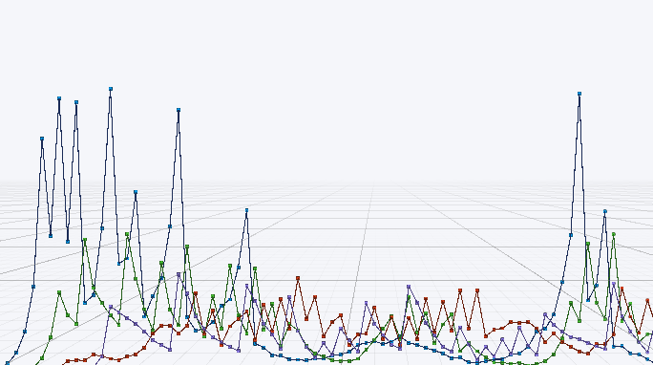
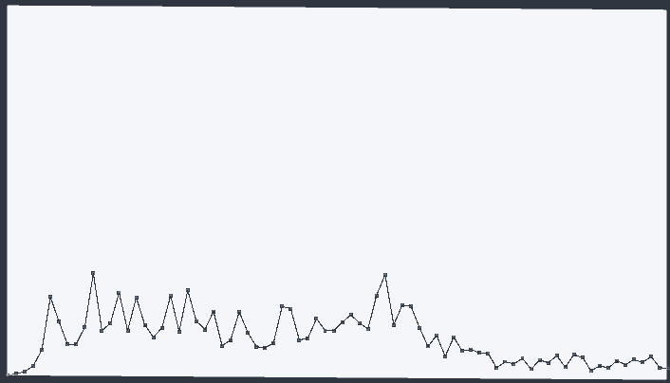
Findings
Population All
Population Average

Slide 10
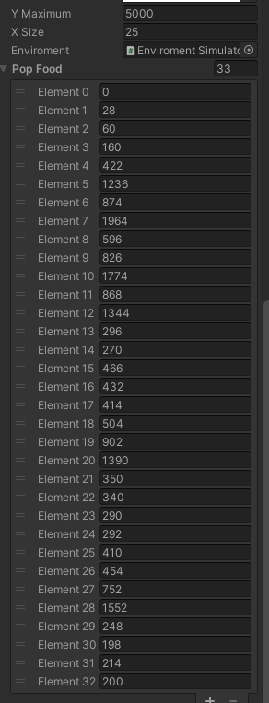
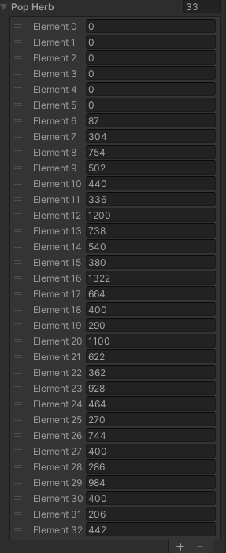
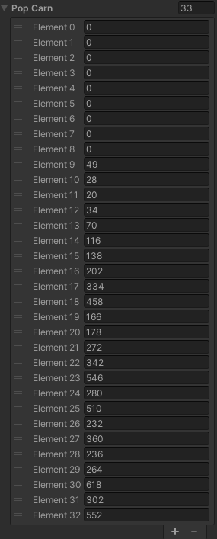
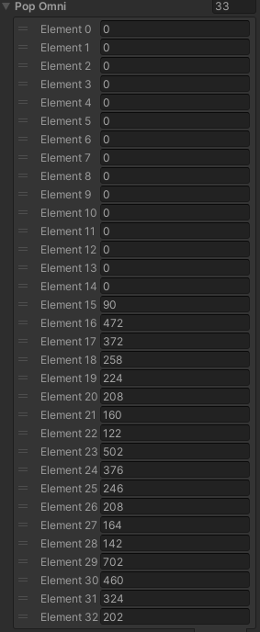
Stats

Slide 11
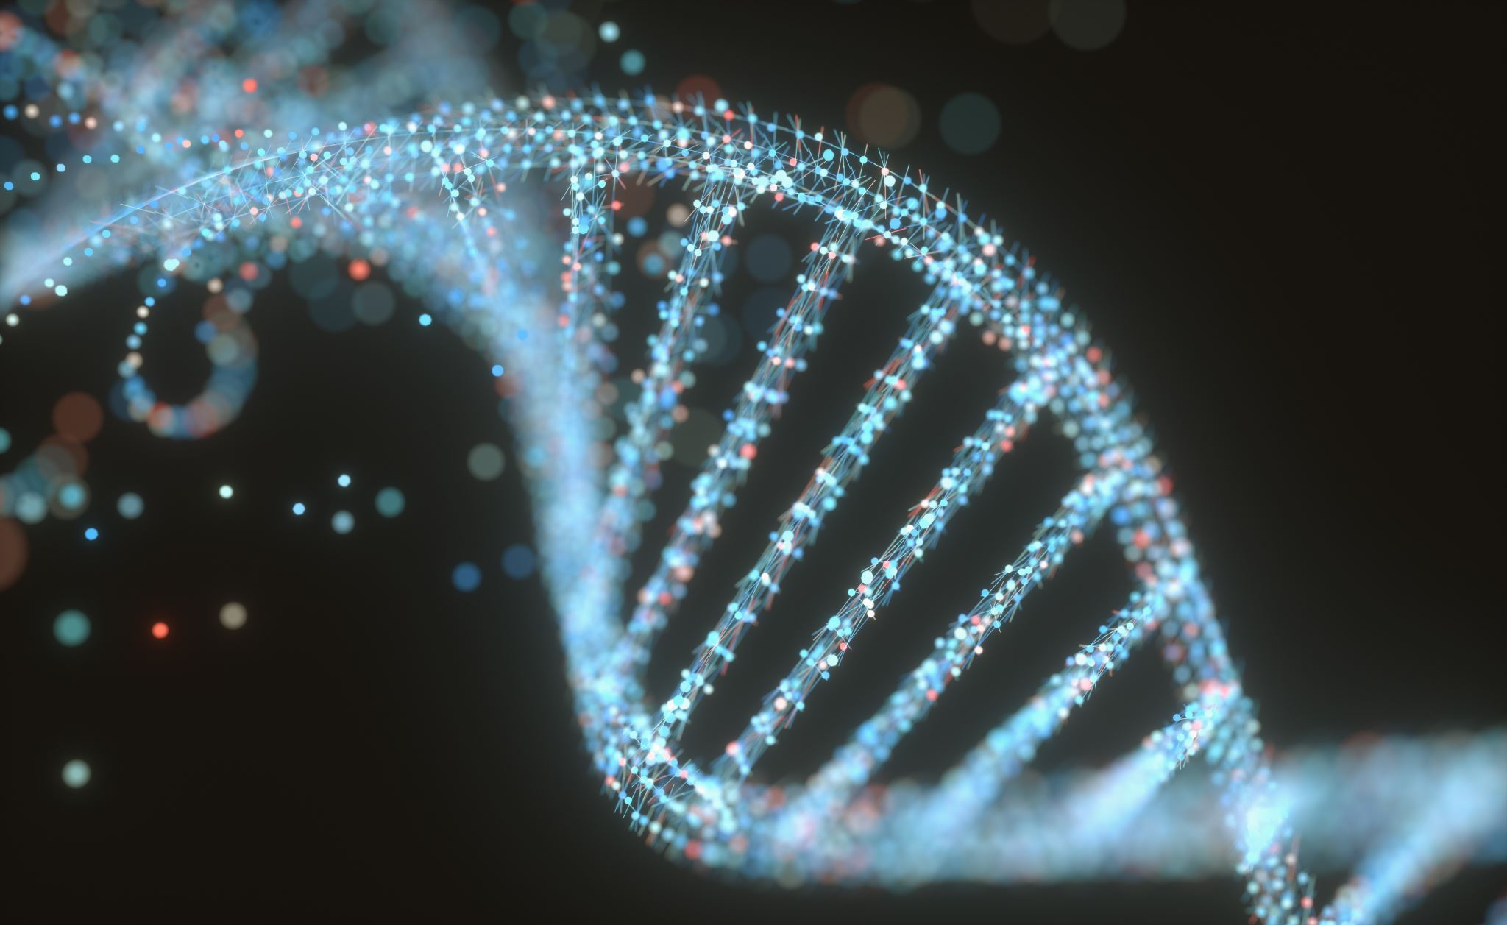
Recap
Thanks for Listening
Github: https://github.com/30005209/AI2

